Slide 1
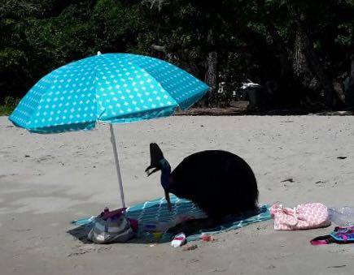
Etty Bay Cassowary Management
Department of Environment and Science
Cassowary Coast Regional Council

Slide 2
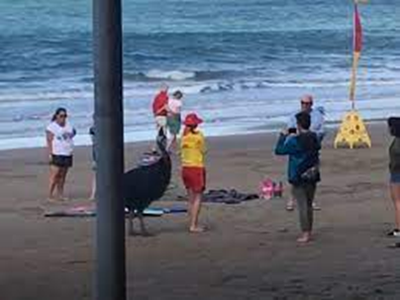
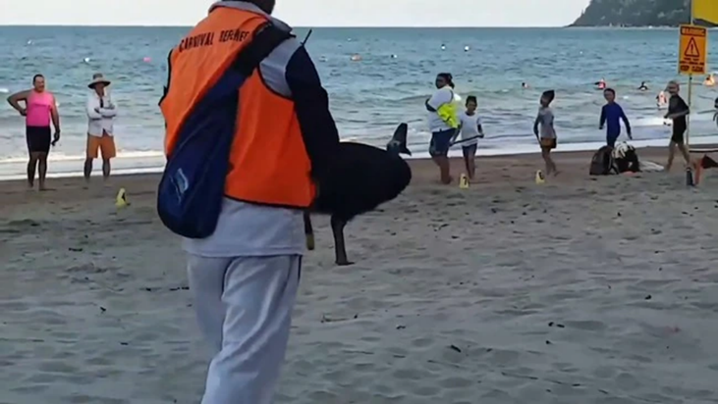
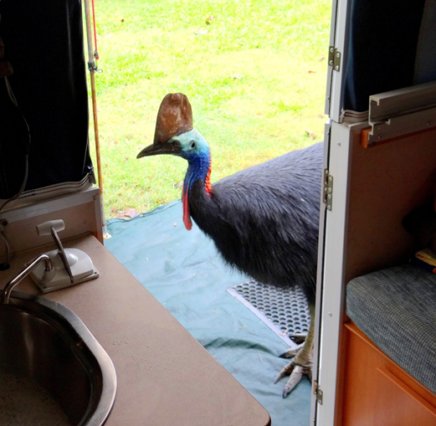
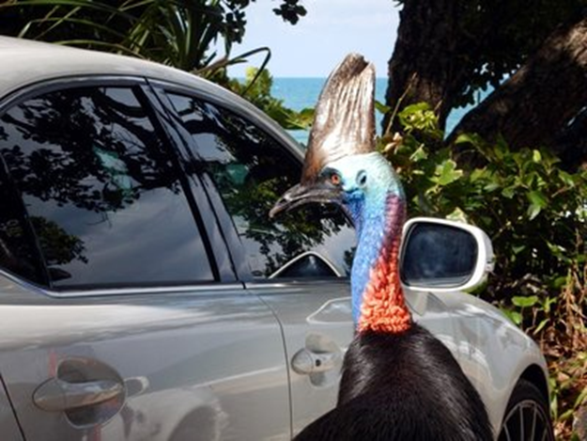
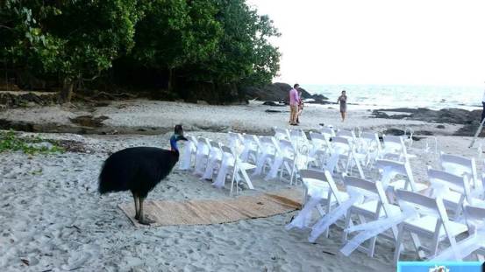

Slide 3
KEY ISSUEs
Ongoing reports (CRT, CCRC Customer Service and DES) about feeding, harassment and misbehaving Cassowaries at Etty Bay.
Existing signage on Cassowary interpretation, and regulatory do not feed signage in place on all CCRC shelters, tables and toilet block is having limited impact on visitor behaviour.
Requests through CRT for corral style fencing and local laws to be introduced to curb human behaviour.
Since 2018 2 Cassowaries have been hazed, then removed as they were becoming dangerous due to feeding creating behaviour issues – Etty Bay has had long history of fed and then dangerous cassowaries, attacking cars, raiding picnics. #Ettybay & #ettybaycarvanpark
Cassowaries are regular visitors to the area and part of the unique attraction of Etty Bay

Slide 4
CURRENT IMPACT/RISK
Current visitor behaviour in unlawful feeding, photography actions (cornering birds) is leading to increased risk of negative interactions occurring.
Damage to vehicles occurs regularly (dark, high gloss vehicles targeted due to reflections)
Cassowary health is being jeopardised through access to non-native foods and deliberate feeding.
Potential for further Cassowary removal by Department of Environment and Science (DES) if human interactions are not controlled.

Slide 5
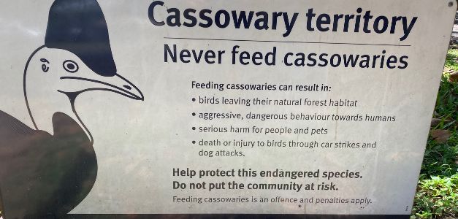
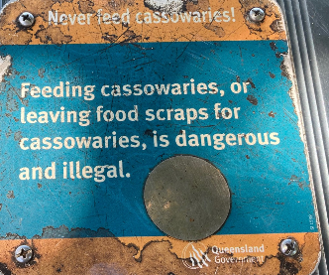
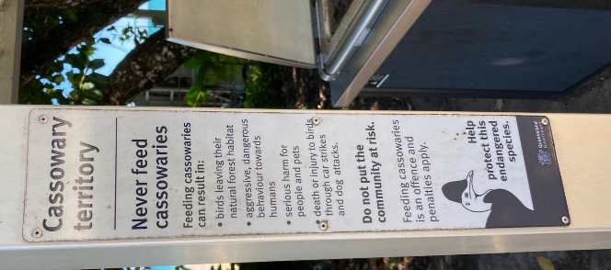
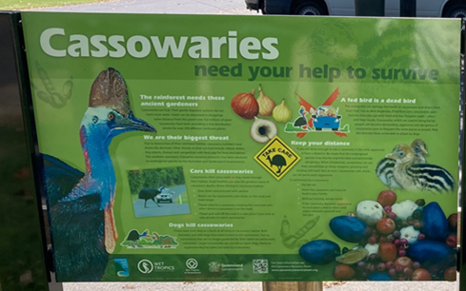
ACTIONS TAKEN
Increased signage installed (No Feeding/regulatory) – funded by DES installed by CCRC on all shelters, tables and amenities block

Slide 6
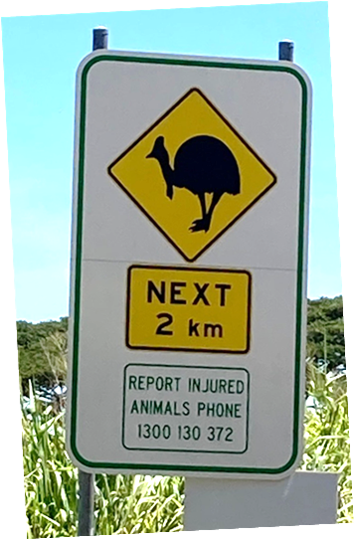
ACTIONS TAKEN
Installation of rope fencing between existing bollards was also utilised to assist cassowary movement.
signage alert driver to cassowaries on range

Slide 7
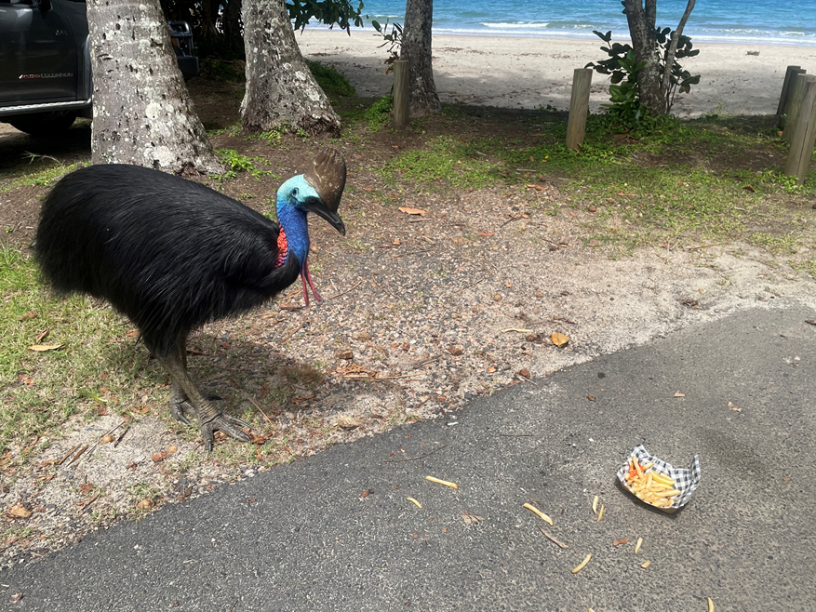
ACTIONS TAKEN
DES Wildlife Officers have undertaken educational letterbox drops to encourage voluntary compliance by locals
Warning letters have been delivered to local residents in accordance with DES compliance guidelines where feeding activities have been confirmed.

Slide 8
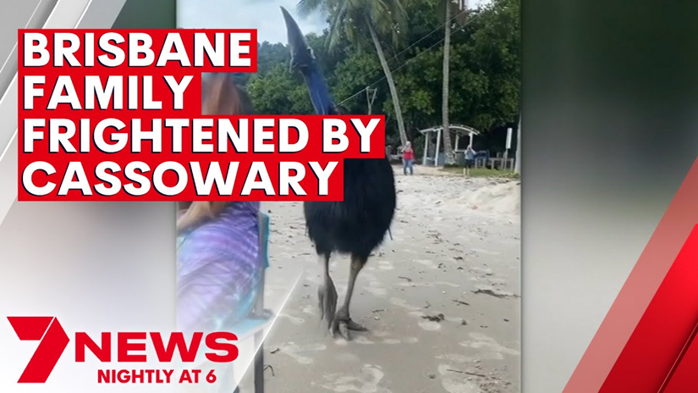
New Approach
Due to limited success from actions outlined above and ongoing issues with Cassowary management at Etty bay a new approach to signage was developed
Novel signage approach – using humour to address key issues of
Feeding
Cornering
Photographing
Vehicle damage
Picnic raiding/Food management
Be CassoWARY branding used
6 signs developed (approx. A3 in size)

Slide 9
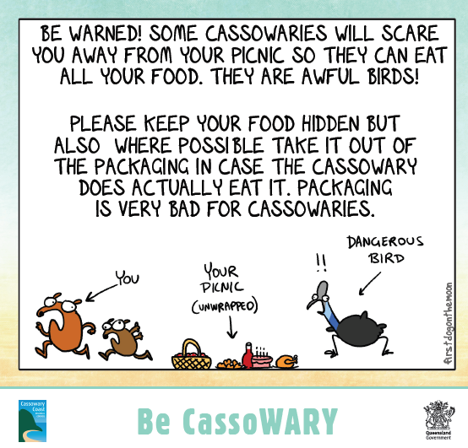

Slide 10
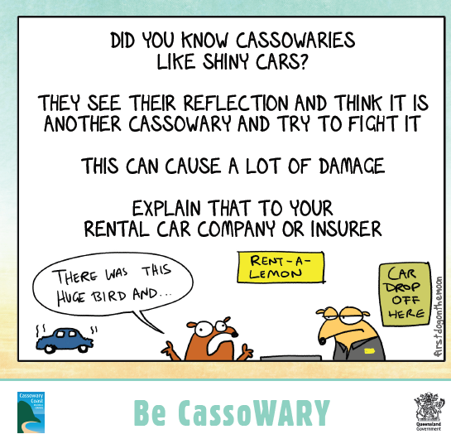
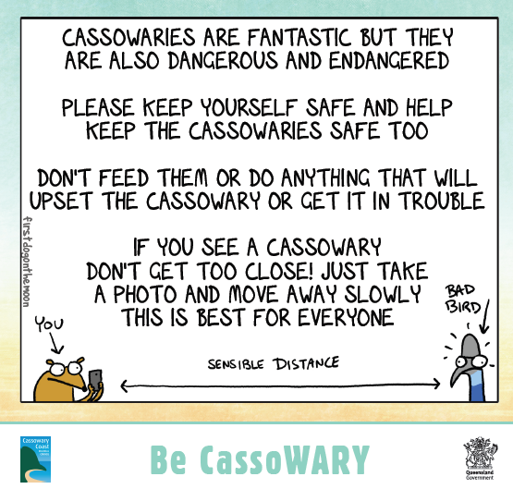

Slide 11
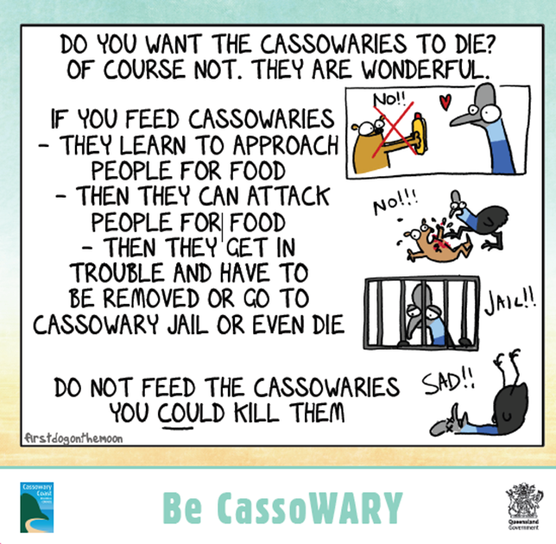
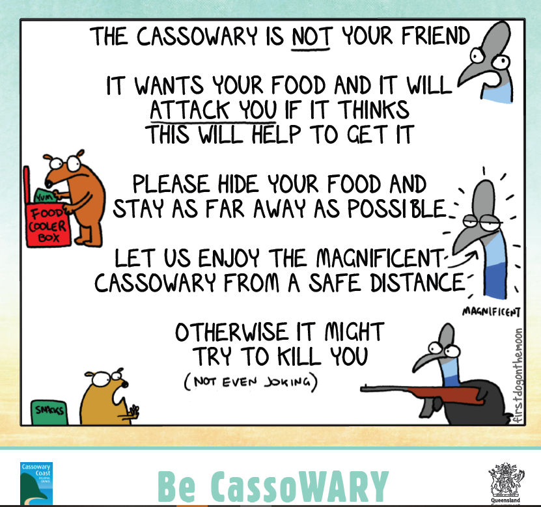

Slide 12
Next steps
CCRC council briefings
Installation of signs in key locations at Etty Bay

